Slide 1
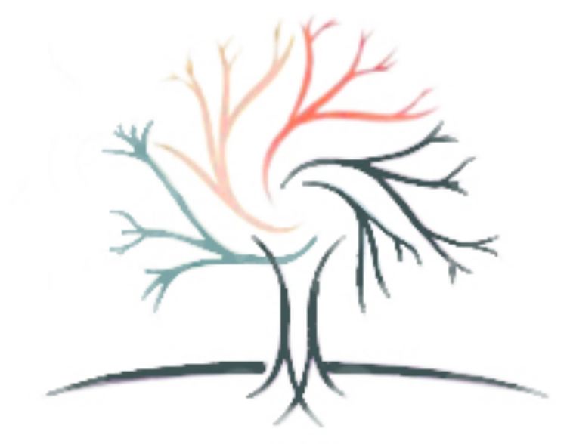
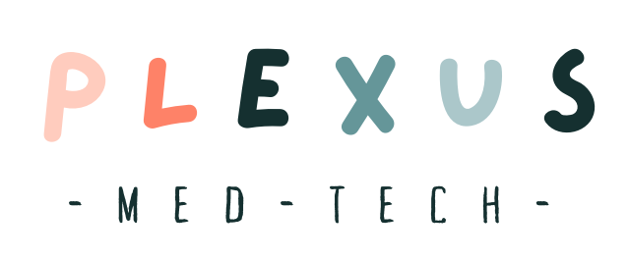
ECONOMIST CV
Maanvitha Akella, Neha Perla, Ananya Mehta
Notes:
Link to script: https://docs.google.com/document/d/1W8ZgSd8i8r2J7rMxM5ou6qZlVN-4-hxXQjoQ2QLdq_Y/edit

Slide 2
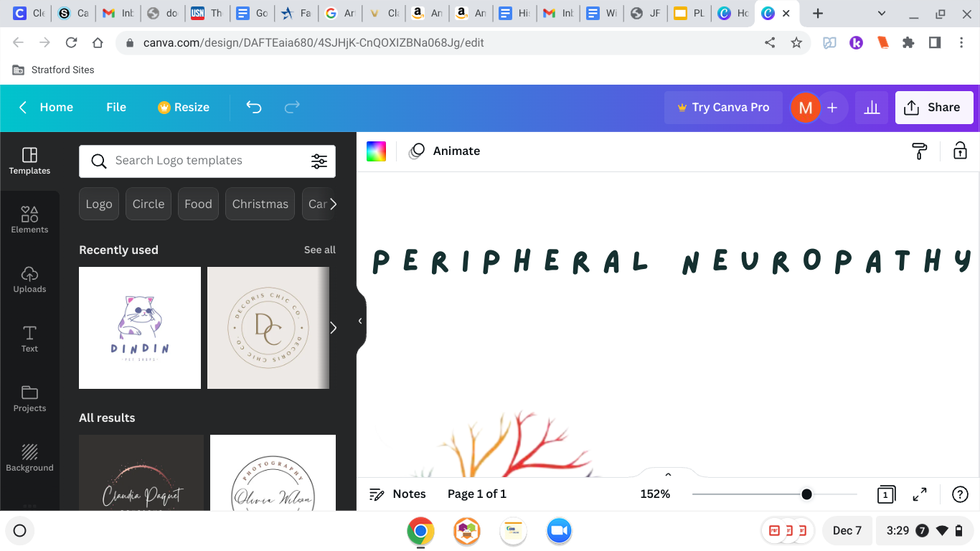
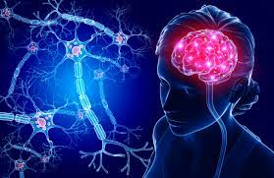
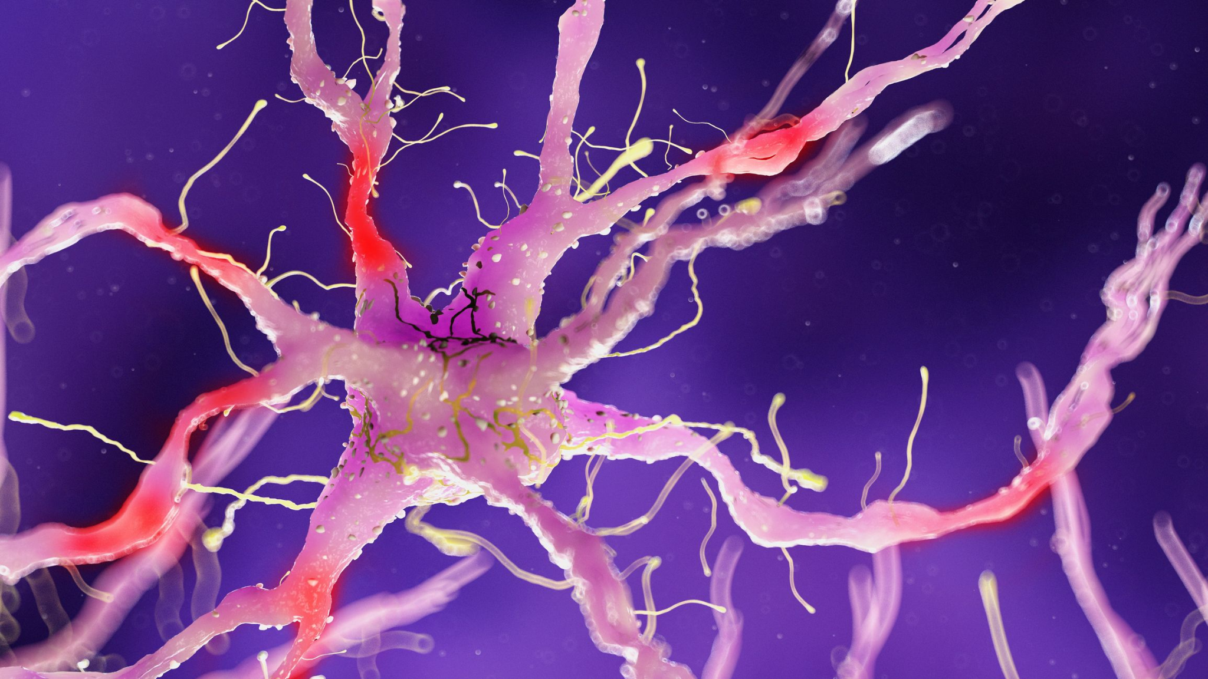

Slide 3
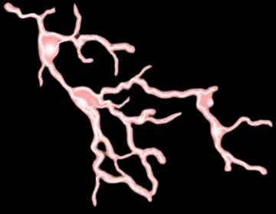
10%
of the global pop.
(About 1 billion ppl)

Slide 4
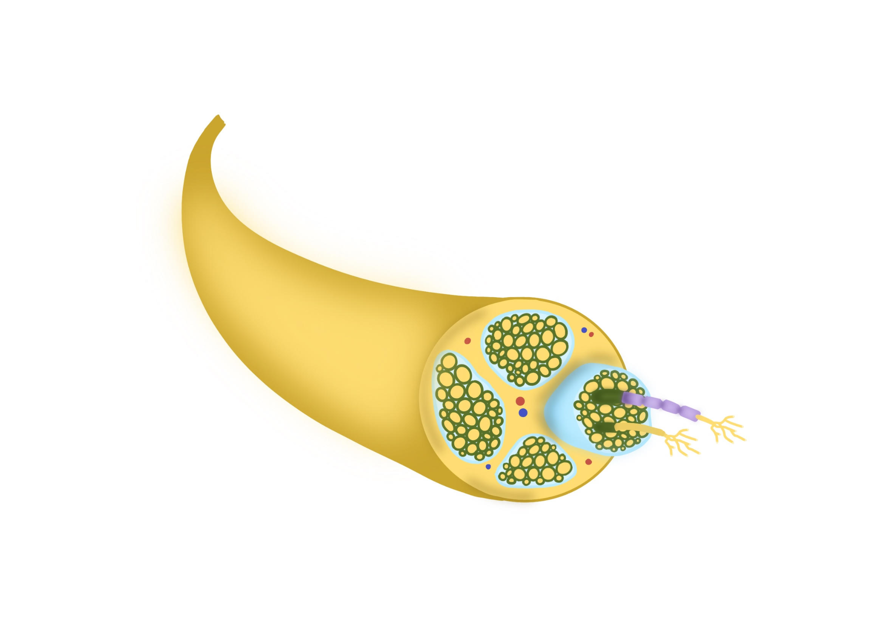
Blood Vessels
*Actual size - 75 microns
Processor
Schwann Cells
Sensor
Nodes of Ranvier
Myelin Sheath
Axon Terminals
Axon
Connective Tissue

Slide 5
Healthy Healthy
Damaged Section
Nerve
Healthy Healthy
Our Product
Replaces the damaged part of the nerve.

Slide 6
:
BIOCOMPATIBLE
SAFE TO USE
HEALS
QUICKLY
HIGH SUCCESS
RATE
LESS TRADEOFFS

Slide 7






Stanford Health Care
NextFlex

Slide 8
BUYERS:
HOSPITALS
COST:
$5,000 - $7,000
USERS:
PATIENTS
Social Media
Spread
Awareness

Slide 9

Our product:
Could potentially change many people’s lives
Future:
Simplify the product & find better ways to manufacture it
Cost-effective
Expand the uses
Currently only used for peripheral nervous system
Maybe expand to the central nervous system and other parts of body

Slide 10


